Slide 1



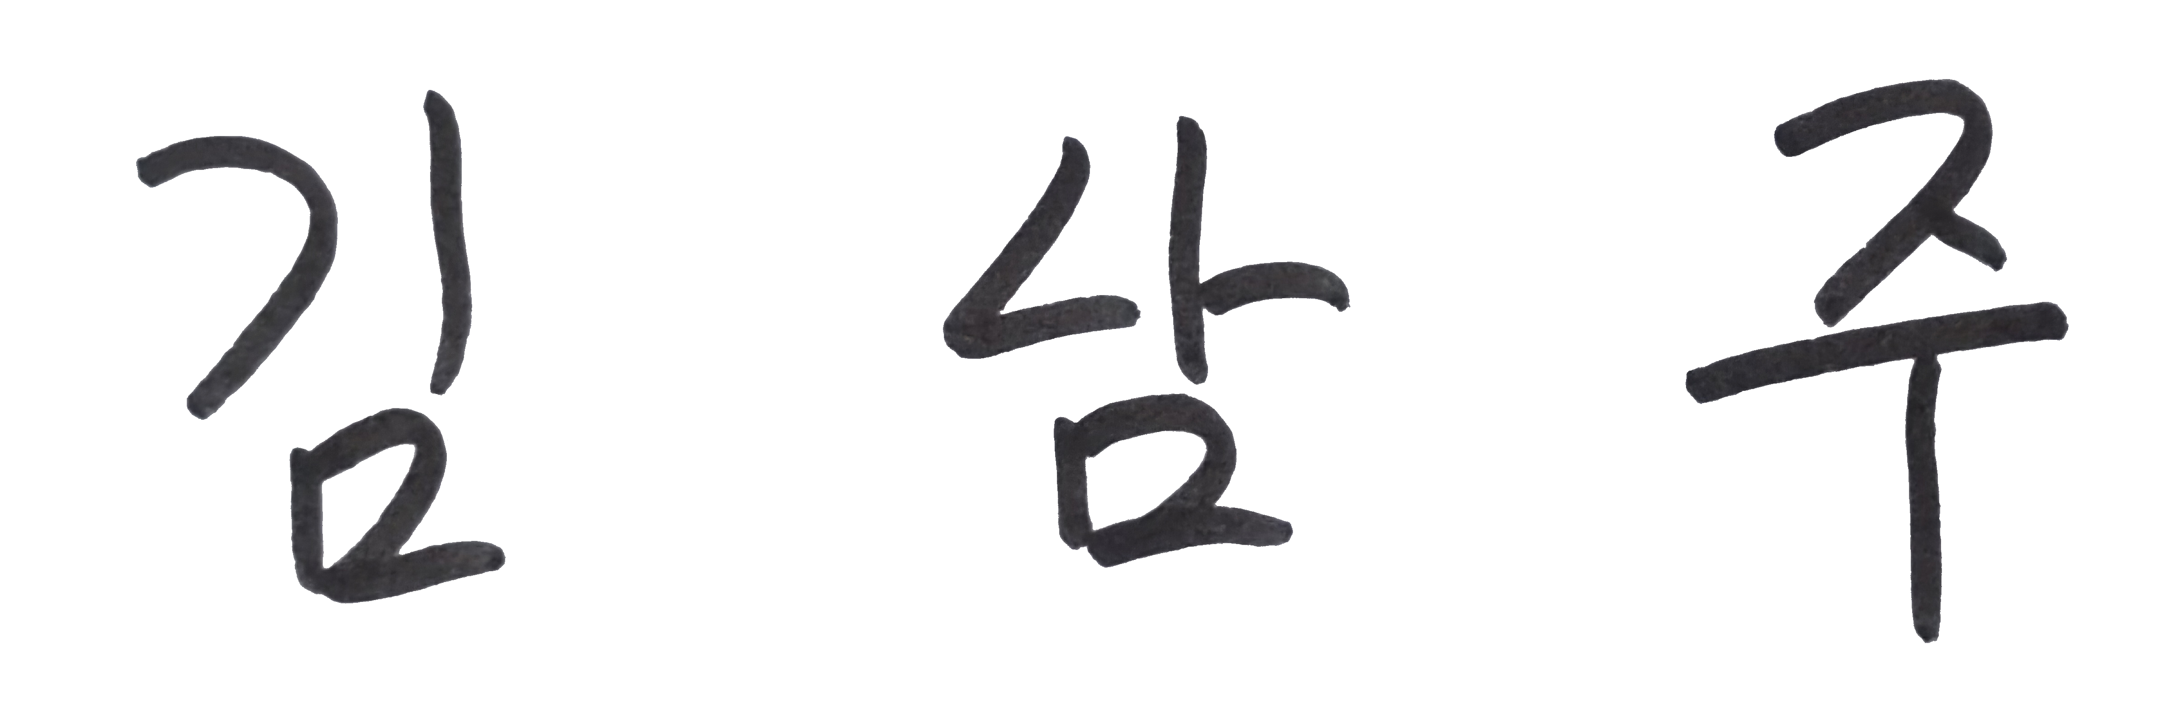
2023 - 2024 GDSC Member
{{ title }}
{{ name }}
{{ content }}
{{ creator }}, {{ organization }}
{{ serialNumber }}

